Slide 1
Opening SDI Metadata for Linked Open Data
Adam Iwaniak
Marek Strzelecki
Jaromar Łukowicz
Iwona Kaczmarek
WIZIPISI - Wrocław’s Institute for Spatial Information and Artificial Intelligence
Wroclaw University of Environmental and Life Sciences

Slide 2
SDI 3.0
Spatial Knowledge Infrastructure
Increasing the role of metadata
Use of standards like RDF, OWL with focus on data publication and integration
SDI 3.0 resources will be a part of Linked Data project
New business model – increased significance of value-added model.

Slide 3
The crisis of INSPIRE metadata
Complex profile and data model of ISO19115 standard
Complex notation of ISO 19139 standard
Old idea of clearing houses, taken straight from libraries before the emergence of the Web
High creation workload, low "searchability" of metadata – very high cost-effectiveness ratio.

Slide 4
HOW CAN WE MAKE existing METADATA MORE USEFUL?

Slide 5
Data discovery in the era of WWW
20 surveys were performed among GI users about searching for spatial data.
Conclusions:
  Limited understanding of the concept of metadata and the methods of their publication
  More than 95% users use Google for searching
  Searching by any text.

Slide 6
Key questions
What are the users` needs?
How to search, integrate, process and infer data?
How to create "sexy" metadata?

Slide 7
WIZIPISI - RDFa new catalogue service
Assumptions:
The metadata is available for web search engines
Metadata is enriched with links to other resources: GEMET, GeoNames, DBpedia
Facilitating access to data - QGIS project
Facilitating access/search of metadata portal

Slide 8
XML Metadata RDF
<gmd:MD_Metadata xmlns:gmd="http://www.isotc211.org/2005/gmd" xmlns="http://www.isotc211.org/2005/gmd" xmlns:gco="http://www.isotc211.org/2005/gco"xmlns:gml="http://www.opengis.net/gml" xmlns:gsr="http://www.isotc211.org/2005/gsr" xmlns:gss="http://www.isotc211.org/2005/gss"xmlns:gts="http://www.isotc211.org/2005/gts" xmlns:srv="http://www.isotc211.org/2005/srv" xmlns:xlink="http://www.w3.org/1999/xlink"xmlns:xsi="http://www.w3.org/2001/XMLSchema-instance" xmlns:geonet="http://www.fao.org/geonetwork">
<gmd:fileIdentifier>
<gco:CharacterString>00Da6ED1-8C2c-49c1-9D25-4ae2E31A620c</gco:CharacterString>
</gmd:fileIdentifier>
<gmd:language>
<gmd:LanguageCode codeList="http://www.loc.gov/standards/iso639-2/" codeListValue="pol">polski</gmd:LanguageCode>
</gmd:language>
<gmd:characterSet>
<gmd:MD_CharacterSetCodecodeList="http://standards.iso.org/ittf/PubliclyAvailableStandards/ISO_19139_Schemas/resources/Codelist/ML_gmxCodelists.xml#MD_CharacterSetCode"codeListValue="utf8">utf8</gmd:MD_CharacterSetCode>
<rdf:RDF xmlns:rdf="http://www.w3.org/1999/02/22-rdf-syntax-ns#" xmlns:dc="http://purl.org/dc/elements/1.1/"xmlns:dcmi="http://purl.org/dc/terms/" xmlns:gco="http://www.isotc211.org/2005/gco"xmlns:gmd="http://www.isotc211.org/2005/gmd" xmlns:md="http://www.kon-dor.pl/metadata#"xmlns:xsi="http://www.w3.org/2001/XMLSchema-instance">
<rdf:Description rdf:about="http://www.kon-dor.pl/metadata/00Da6ED1-8C2c-49c1-9D25-4ae2E31A620c.rdf">
<dc:identifier>00Da6ED1-8C2c-49c1-9D25-4ae2E31A620c</dc:identifier>
<dc:date/>
<dc:title>84.05.1 (Hajnówka)</dc:title>
<dc:subject>Budynki</dc:subject>
<dc:subject>Hydrografia</dc:subject>
<dc:subject>Nazwy geograficzne</dc:subject>
<dc:subject>Sieci transportowe</dc:subject>
<dc:subject>Ukształtowanie terenu</dc:subject>
<dc:subject>Punkty osnowy geodezyjnej</dc:subject>
<dc:subject>Koleje i obiekty z nimi związane</dc:subject>
<dc:subject>Drogi i obieky z nimi

Slide 9
XML to RDF conversion
Metadata created with RDF model and accessible through SPARQL end-point – approach equivalent to CS-W.
The problem of unavailability of metadata for web search engines is still not solved

Slide 10
How can we publish metadata in SDI 3.0

Slide 11
RDFa - Resource Description Framework in Attributes
Enables embedding RDF subject-predicate-object expressions within (X)HTML documents.
Embedd metadata within (X)HTML web documents.
Enables processors (web robots) to extract RDF triples from (X)HTML .
Both machine and human readable.

Slide 12
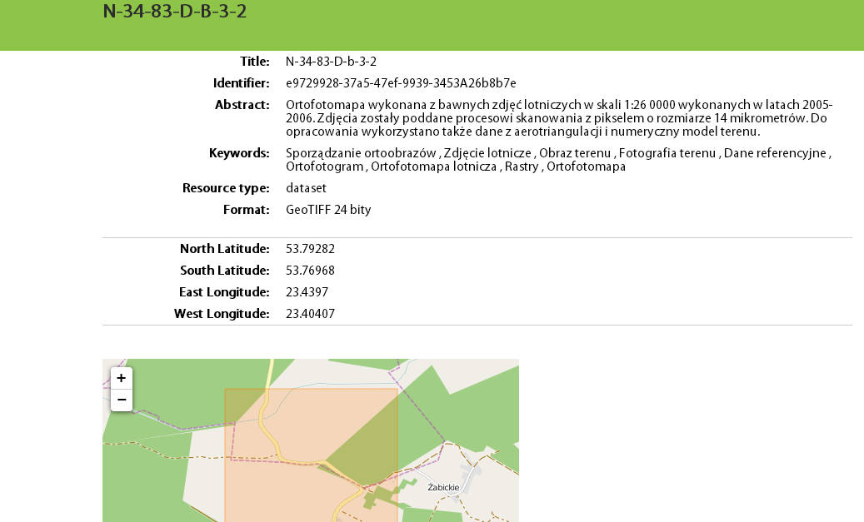
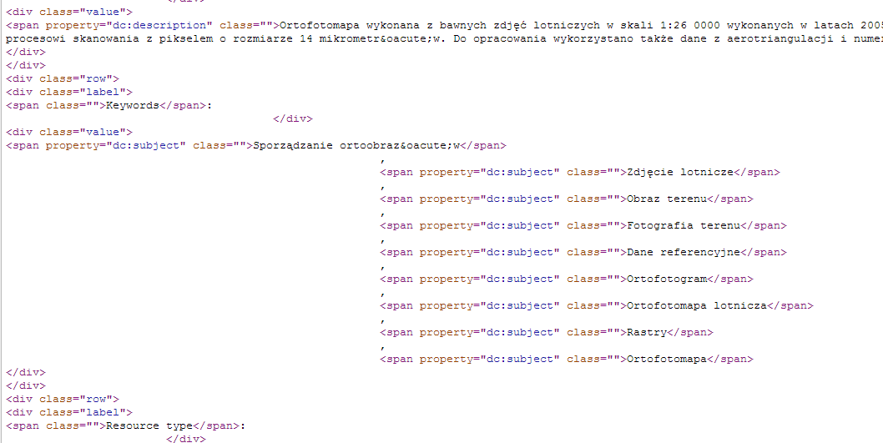
(X)HTML + RDFa

Slide 13
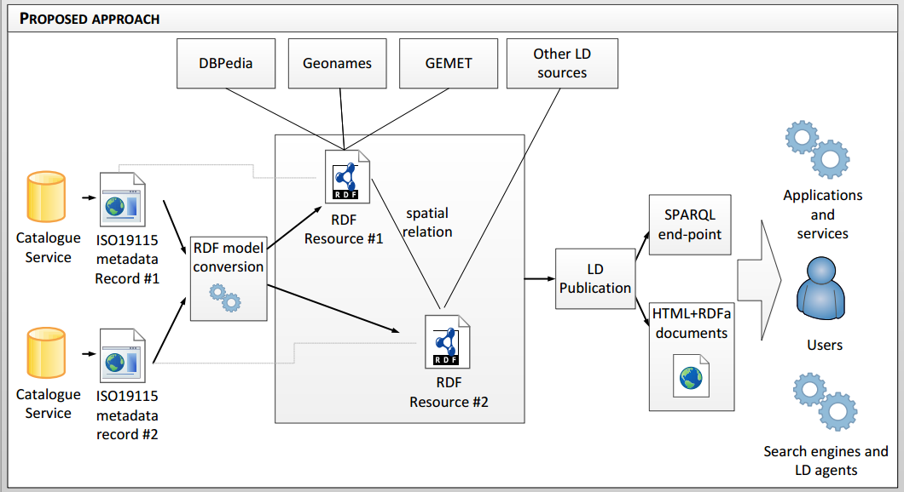
HTML+RDFa metadata publication

Slide 14
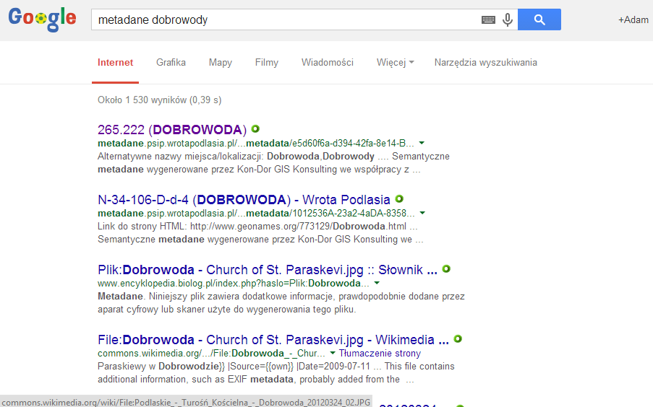
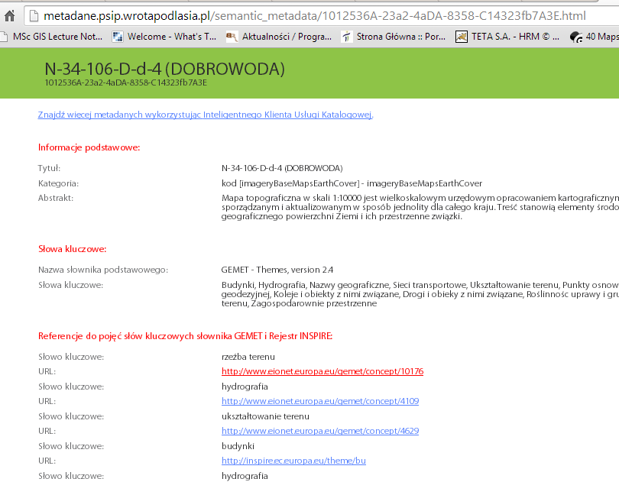
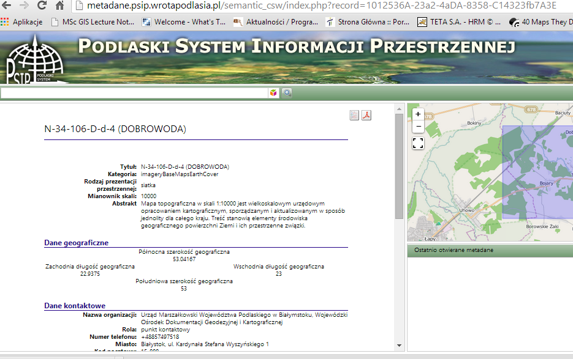
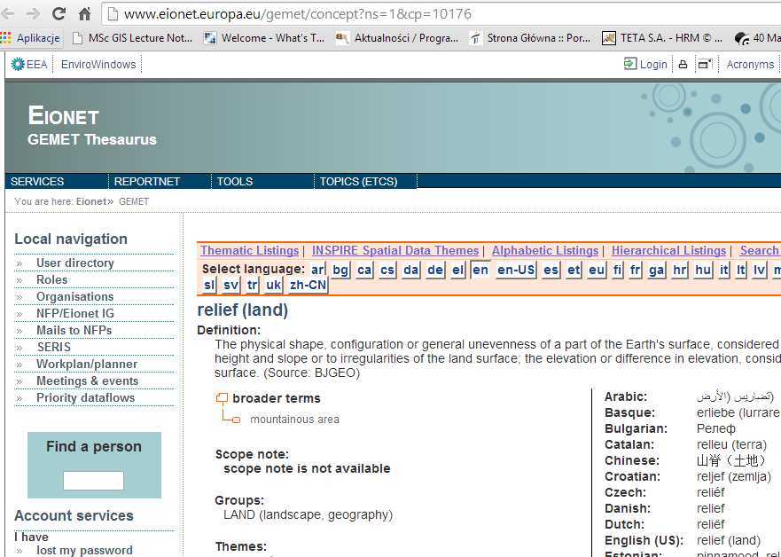
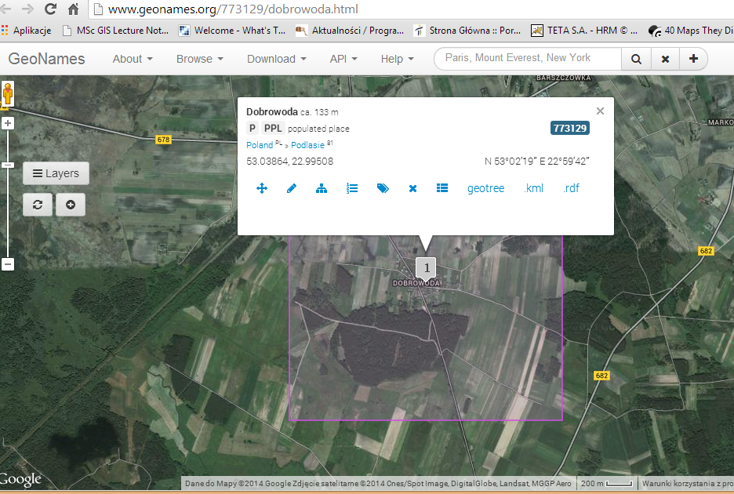
A.Iwaniak, The INSPIRE Conference 2014, Aalborg, 16-20 June 2014

Slide 15
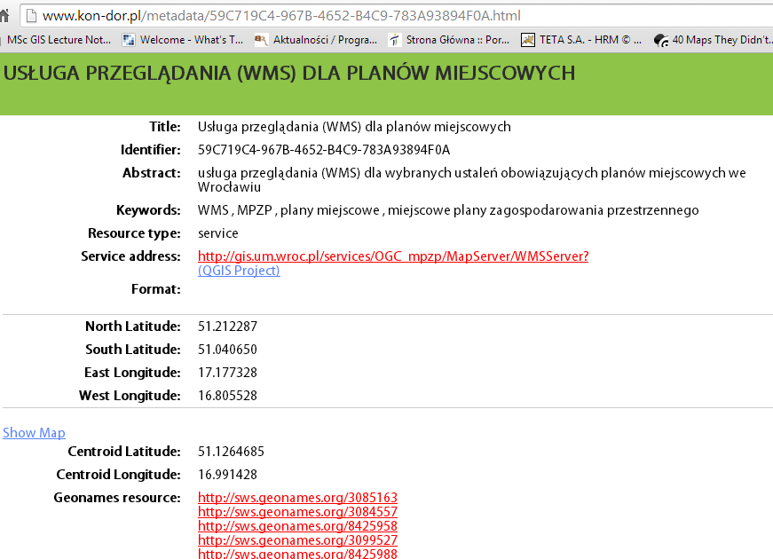
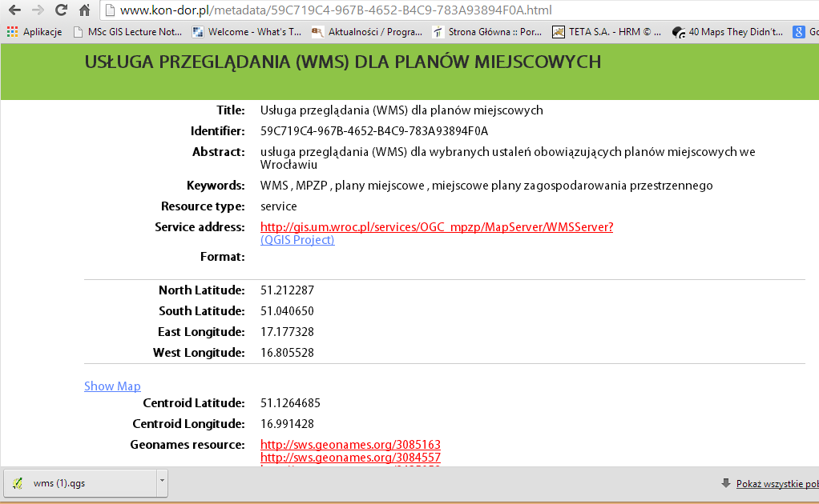
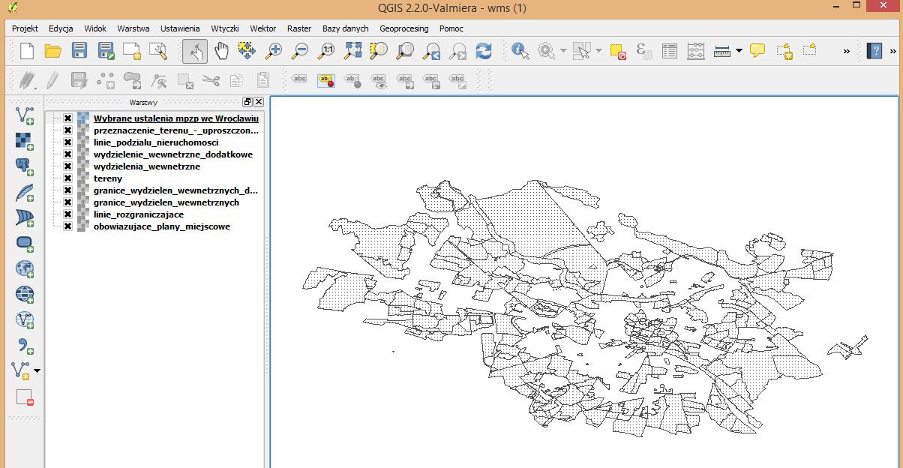
Facilitating access for direct use - QGIS
A.Iwaniak, The INSPIRE Conference 2014, Aalborg, 16-20 June 2014

Slide 16
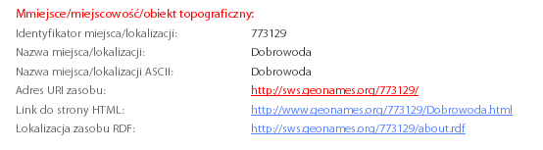
Bbox, location
<span property="geo:lat" class="centLat">53.583335000000005</span>
<dc:coverage>
North 52.83312, South 52.49977, East 23.66485, West 23.16483.
</dc:coverage>
<dcmi:Box rdf:parseType="Resource">
<dcmi:northlimit>52.83312</dcmi:northlimit>

Slide 17
URI and metadata identifier
All published resources should have their own URI
URI should be dereferable (with requested MIME types)
URI of metadata can be based on catalogue address and record identifier.

Slide 18
Metadata in RDFa - conclusions
Facilitating access to metadata web search engines
Easier access to data - QGIS
Relationships with other resources
Easier access to the CS-W (HTML refers to CS-W)
Mess with the metadata in the Web
Dependence on third parties such as Google's, Bing
Change metadata ID for URI

Slide 19

adam.iwaniak@wizipisi.pl
http://www.wizipisi.pl

